Slide 1
Part I, II, III in New Bern
August 24th 2024 Garber Methodist Church Trent Woods NC

Slide 2
Eastern North Carolina
Part I
Part II
Part III
August 24th in New Bern
Part I, II, and III
Garber Methodist Church
4201 Country Club Road
Trent Woods NC 28562
Register now on
Dacdb or at RLI33.org

Slide 3
Part I Part II Part III in New Bern
August 24th 2024 Garber Methodist Church Trent Woods Nc

Slide 4
August 24th in New Bern
Part I, II, and III
Garber Methodist Church
4201 Country Club Road
Trent Woods NC 28562

Slide 5
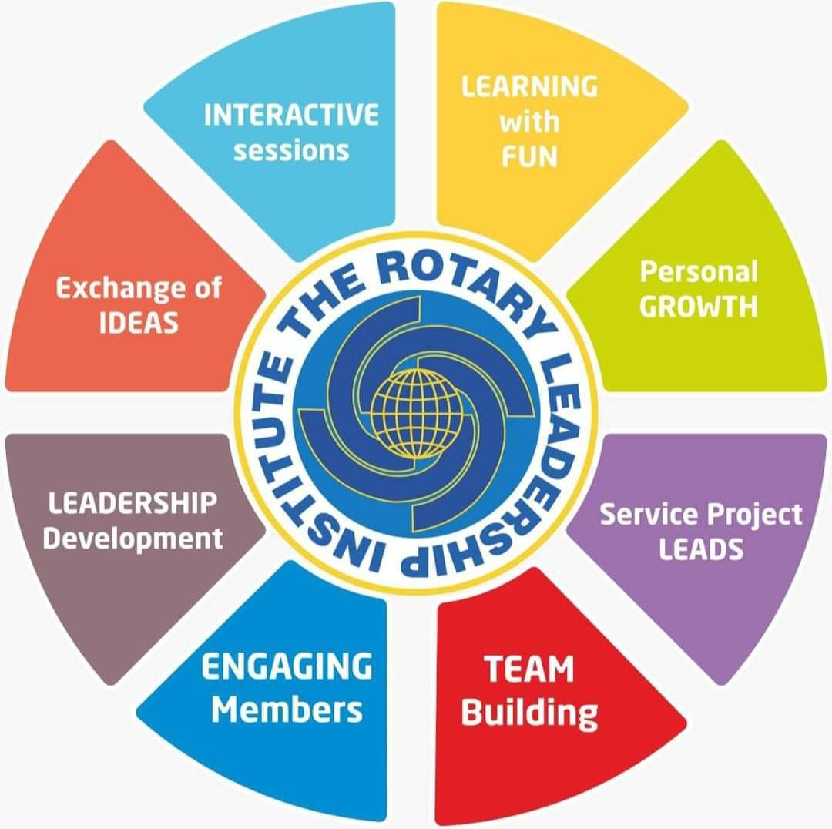
August 24th in New Bern
Part I, II, and III
Garber Methodist Church
4201 Country Club Road
Trent Woods NC 28562
Part I
Part II
Part III
Register now on Dacdb or at RLI33.org

Slide 6
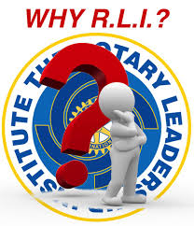
The Rotary Learning Institute (RLI) program is a series of fast-paced, interactive courses offered to refine a Rotarian’s leadership skills and increase their base of knowledge in Rotary. Courses are fun, topical, interactive, and geared to busy business, professional and community leaders who want to be more effective leaders in their vocation and Rotary club, and more knowledgeable Rotarians.
August 24th in New Bern
Part I, II, and III
Garber Methodist Church
4201 Country Club Road
Trent Woods NC 28562

Slide 7
RLI in NEW BERN
August 24th in New Bern
Part I, II, and III
Garber Methodist Church
4201 Country Club Road
Trent Woods NC 28562
Part I
Part II
Part III
Register now on Dacdb or at RLI33.org

